Slide 1
Mortality in the US By Demographics
Ivana Lin and Ricky Ma

Slide 2
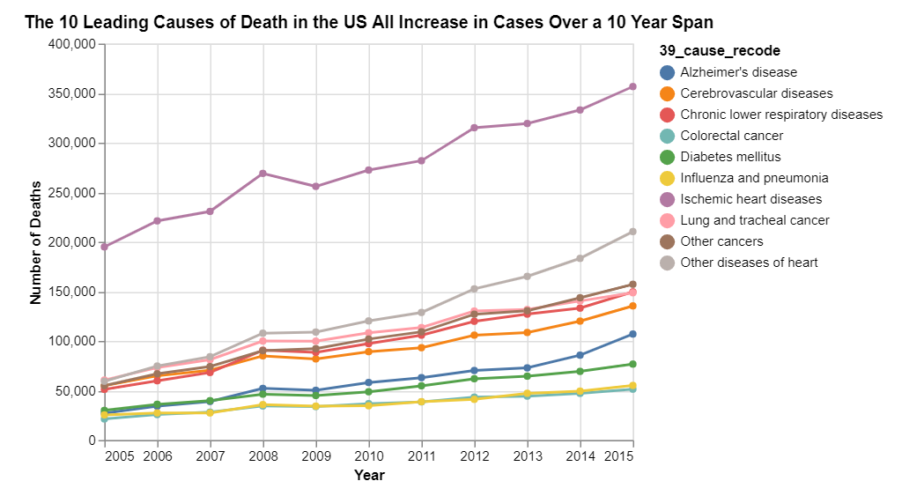
Key Findings

Slide 3
Our Data
CDC’s National Vital Statistics Systems
Spans 2005 to 2015
Each year’s data contained in individual csv files
Number of rows varies
At least 2 million rows each
77 columns each
Each row details a death in the US
https://www.kaggle.com/cdc/mortality

Slide 4
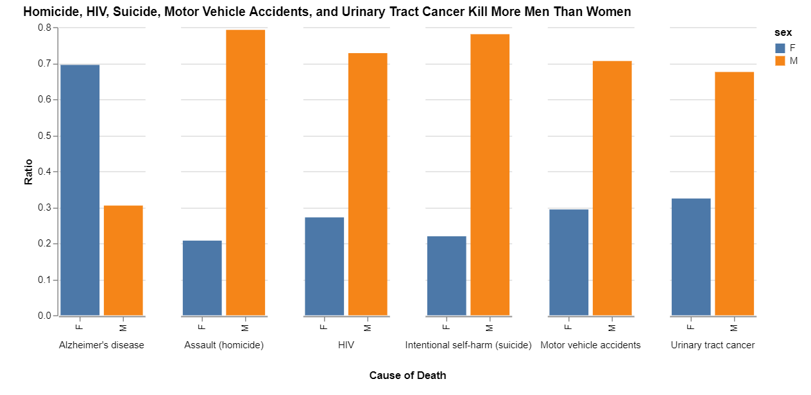
Our Findings: Sex

Slide 5
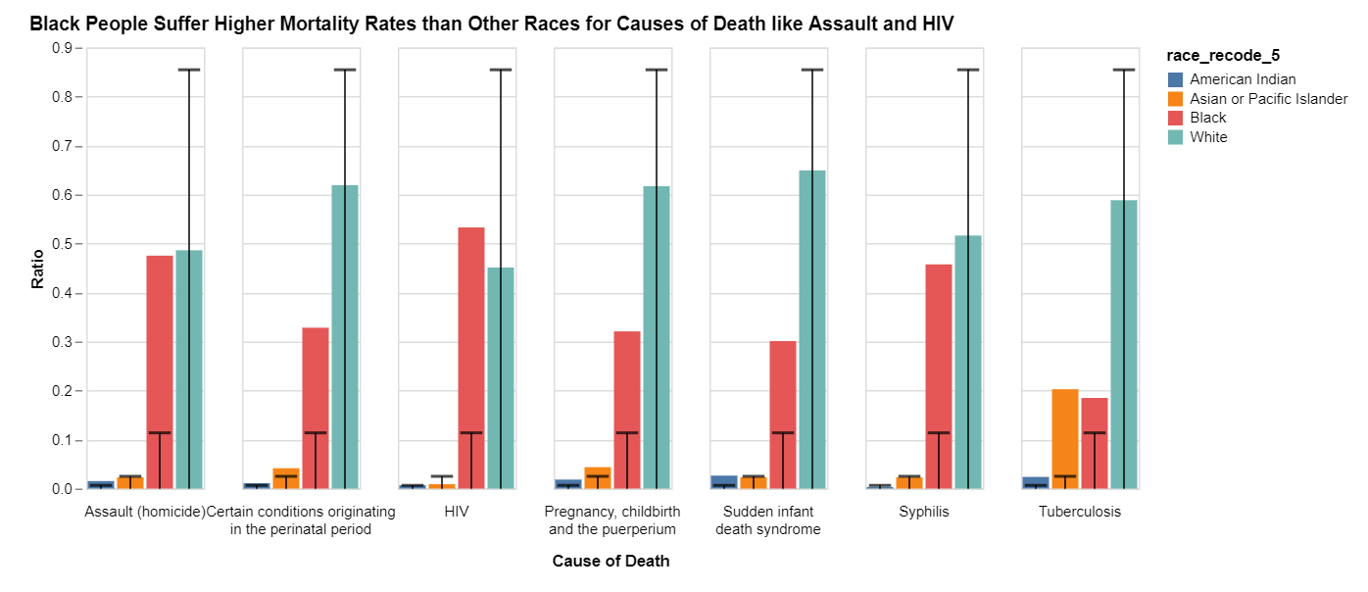
Our Findings: Race

Slide 6
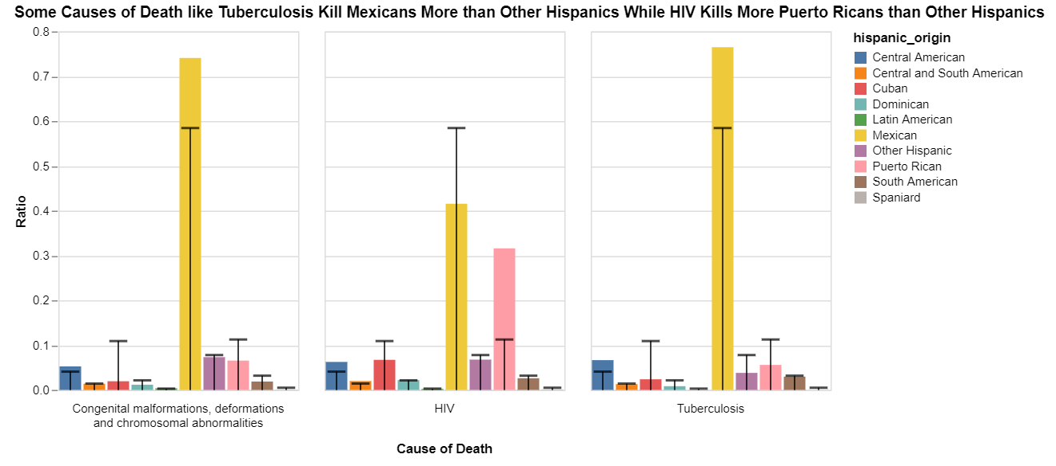
Our Findings: Hispanic Origin

Slide 7
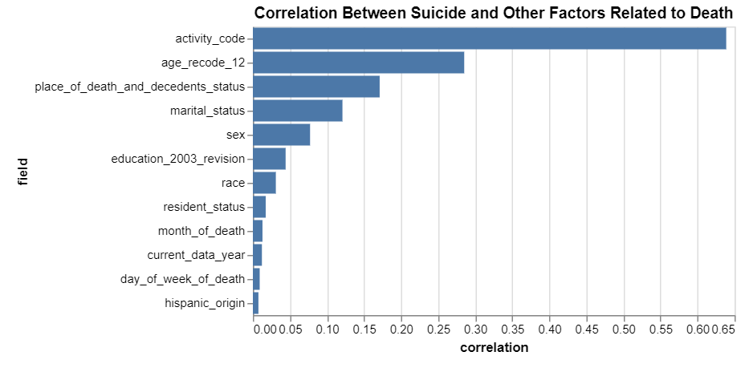
Our Findings: Suicide Correlations

Slide 8
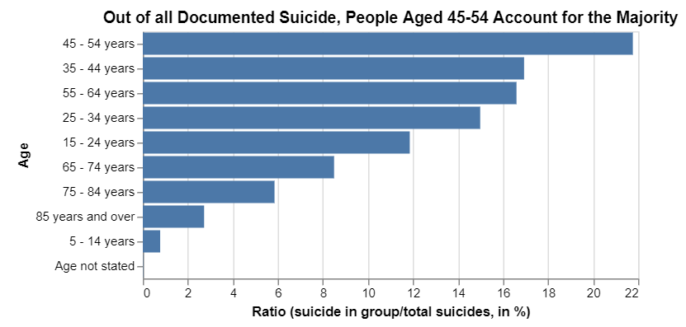
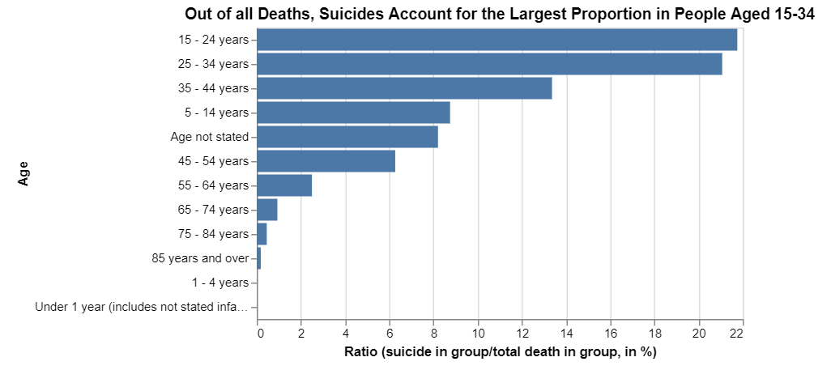
Our Findings: Suicide and Age

Slide 9
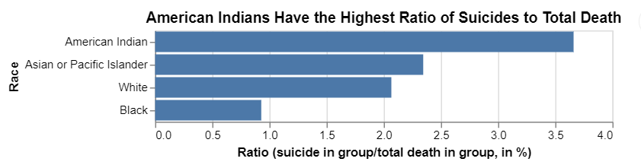
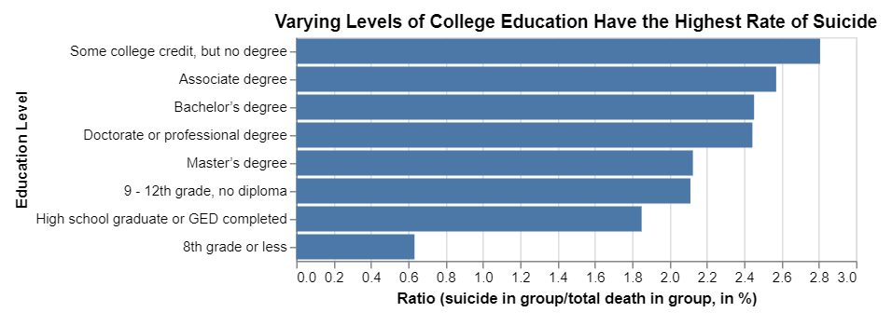
Our Findings: Education, Race, and Suicide

Slide 10
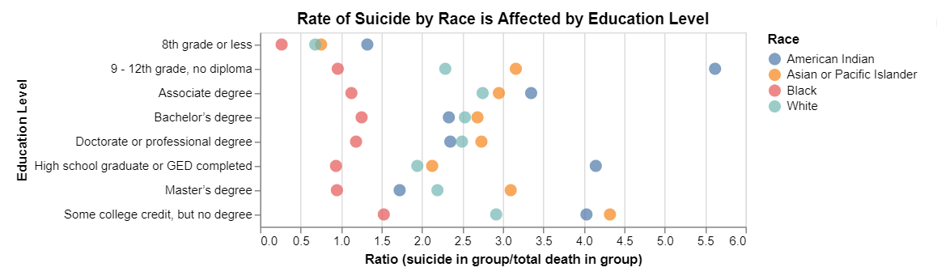
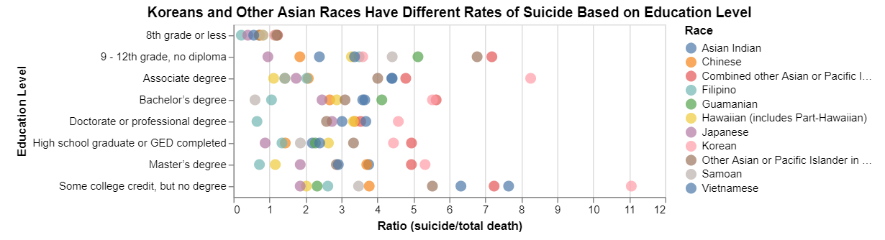
Our Findings: Education, Race, and Suicide

Slide 11
Key Findings

